Slide 1
Title: Amazon Product Sales Analysis
Student Name: Avula Karthik
Registration Number: 12212224
Roll.No:45
Section:k22UG
Submission Date: September 2024
Purpose of Project: This project aims to analyze an extensive dataset of Amazon product sales to uncover trends and patterns in product categories, pricing, and consumer ratings, ultimately providing valuable insights for strategic decision-making in e-commerce.

Slide 2
Table of Contents
Introduction
Literature Review and Problem Statement
Methodology
Exploratory Data Analysis (EDA)
Statistical Analysis
Unique Graphs and Comparisons
Results
Conclusion
References
Thank You

Slide 3
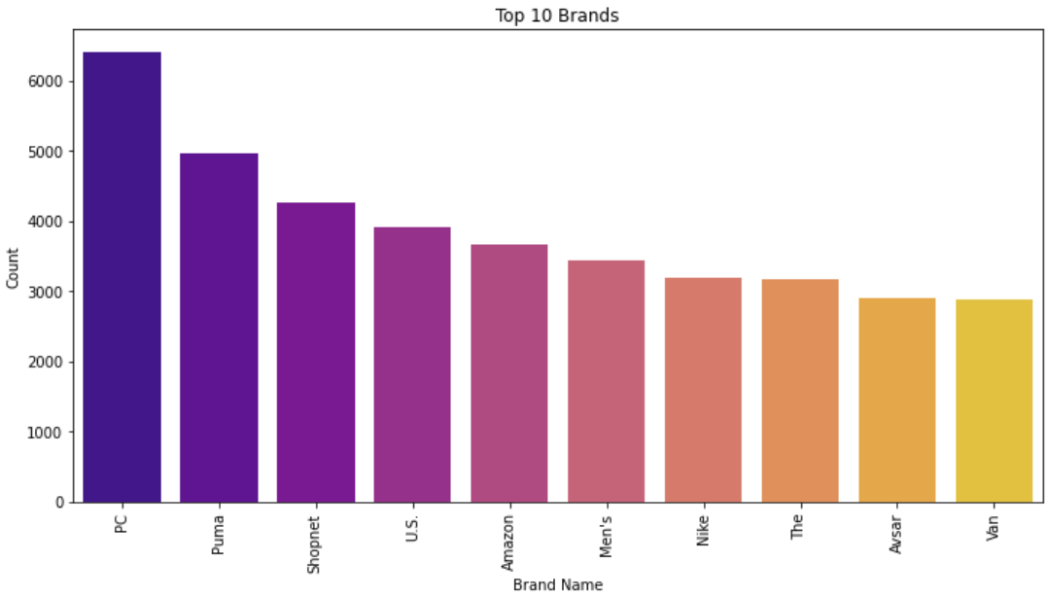

Amazon Product Sales Analysis
This project analyzes Amazon product sales data to uncover trends and patterns in product categories, pricing, and consumer ratings.
by Avula karthik

Slide 4


Introduction
Amazon, a global e-commerce giant, offers a vast range of products and collects extensive data on prices, ratings, and customer reviews. Context: Amazon, on of the largest online marketplaces, offers a ide range of products and accumulates extensive data related to prices,ratings and customers reviews. With over 550,000 product entries in this dataset, we aim to leverage this information for insights into customers preferneces,pricing strategies and product performance.
1
Objective 1
2
Objective 2
3
Objective 3
Perform exploratory data analysis (EDA) to identify key trends in product categories, pricing, and customer ratings.
Address data quality issues such as missing values and inconsistent formats.
Visualize key insights to aid in understanding market trends, customer behaviors, and areas for product improvement.

Slide 5

Literature Review and Problem Statement
Previous research highlights the impact of e-commerce data analysis on understanding consumer behavior, product demand, and pricing optimization.Studies show the importance of data-driven decision-making for pricing, inventory management, and customer satisfaction in online retail..
Problem Statement
How can Amazon’s sales data be utilized to identify patterns in pricing, ratings, and consumer satisfaction?
This project aims to analyze data on product categories, prices, and customer ratings to inform business strategies that improve product
positioning, pricing approaches, and enhance customer experience on Amazon.

Slide 6
Methodology
The project utilizes data collection, cleaning, and analysis techniques to extract valuable insights from the Amazon product sales dataset.
1
Data Collection
Dataset sourced from Kaggle, with 550,000+ product entries, including columns like product name, category, price, and ratings.
2
Data Cleaning
Addressed missing values by either filling with mean/median values or deleting where over 70% of data was missing.
Converted text-based price and rating columns to numeric formats.
Removed duplicate records to ensure data integrity.
3
Data Inspection
Assessed dataset structure, variable types, and missing data.
4
Exploratory Data Analysis (EDA)
Visualized data distribution, calculated statistics, and generated a correlation matrix.
5
Statistical Analysis
Applied techniques like descriptive statistics, ANOVA, t-tests, and Pearson correlation.
6
Python for scripting
pandas for data manipulation
Matpltlib & Seaborn for visualizations
plotly for interactive graphing

Slide 7
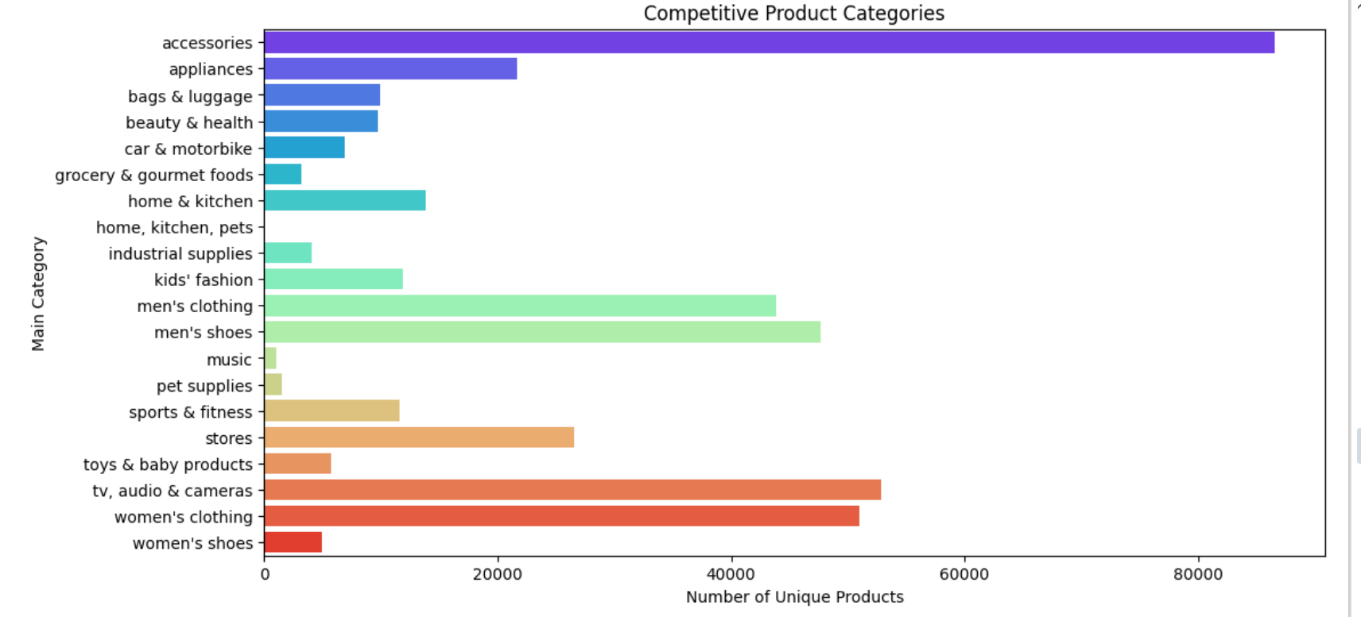
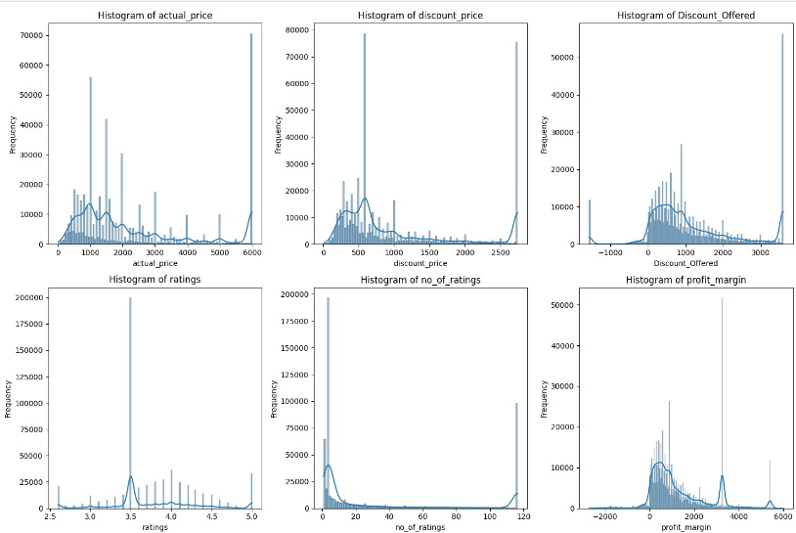
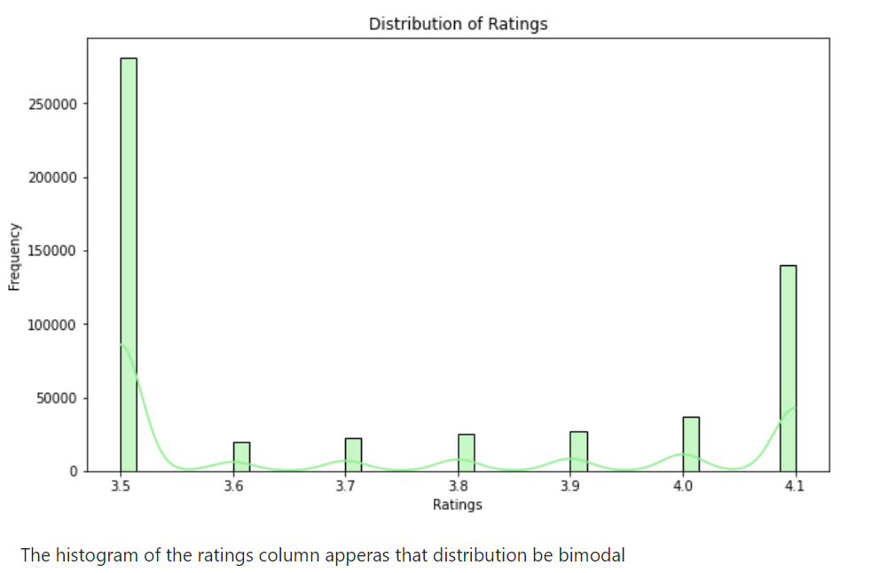
Exploratory Data Analysis (EDA)
EDA revealed key trends in product categories, pricing, and customer ratings.
Category Distribution
Price Trends
Customer Ratings
Categories like “Appliances,” “Men’s Clothing,” and “Accessories” had the highest product counts.
Significant variance in price distribution between categories, with appliances generally having higher prices.
Distribution of ratings showed most products were rated 3-5 stars, suggesting positive customer feedback.

Slide 8

Statistical Analysis
Statistical techniques were applied to further analyze the data and identify key insights.
Descriptive Statistics
Calculated measures such as mean, median, and standard deviation for prices and ratings.
Outlier Detection
Identified outliers in price and rating data using box plots.
Correlation Matrix
Analyzed relationships between numeric variables such as price, discount, ratings, and number of reviews.
ANOVA and T-Tests
Compared product prices and discounts across brands to identify significant differences.

Slide 9
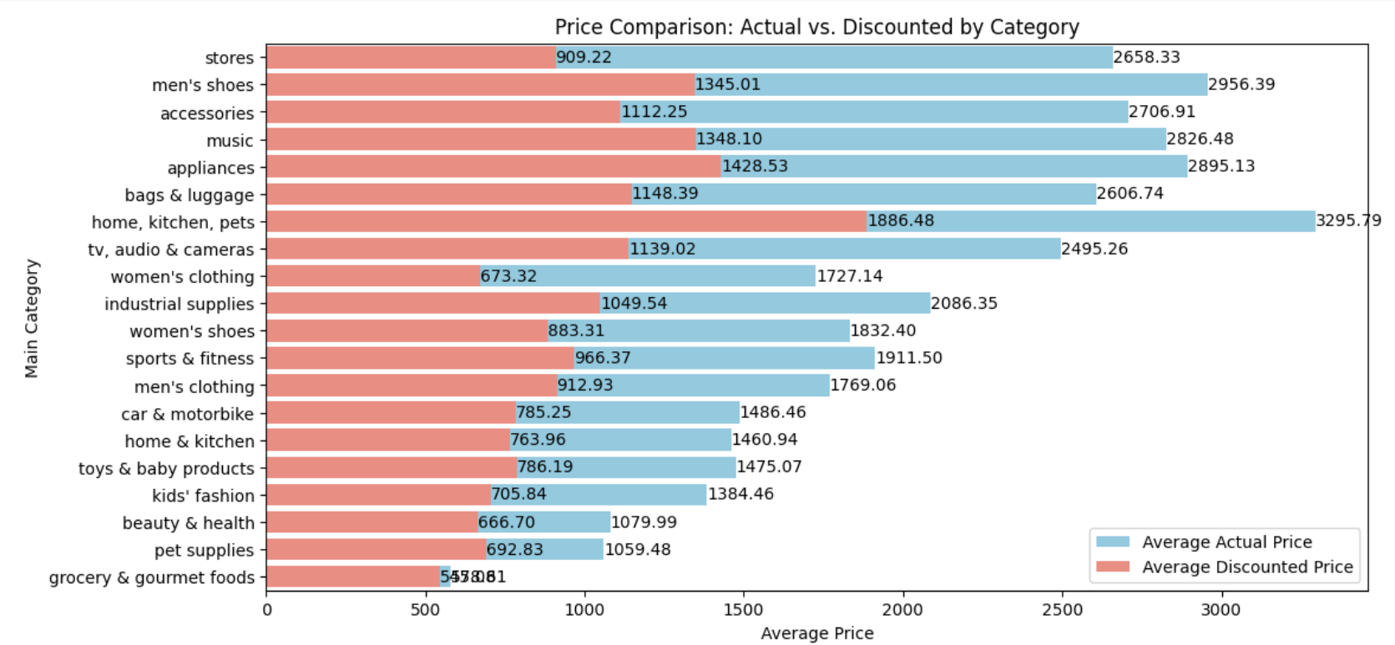
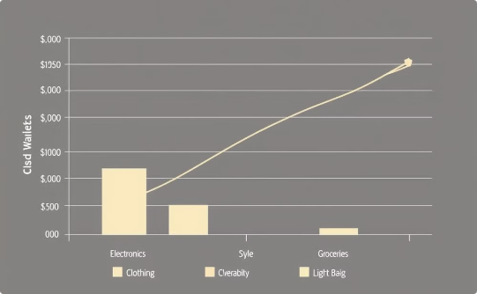
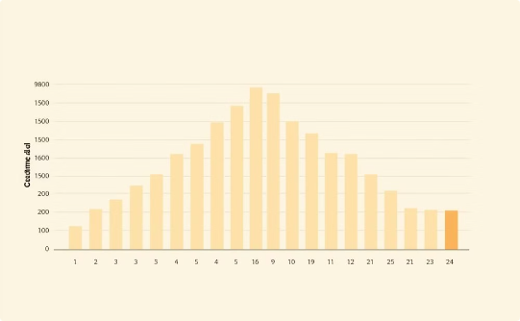
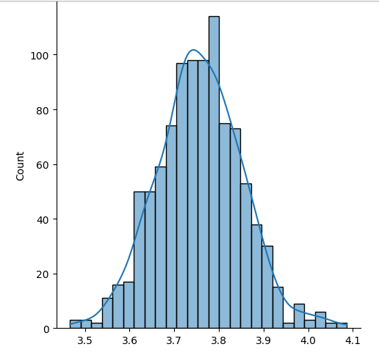
Unique Graphs and Comparisons
The project utilized unique graphs and comparisons to visualize key insights from the data.
Graph 1
Graph 2
Graph 3
Highlights top categories by product count, such as “Appliances” and “Men’s Clothing.”
Shows price ranges within categories, revealing which categories are higher-priced, like “Appliances.”
Displays frequency of ratings across products, showing a tendency for mid-to-high ratings, indicating generally positive customer feedback.

Slide 10

Results
The analysis revealed key insights into Amazon’s product categories, pricing, and customer ratings.
Competitive Landscape:
“Men’s Clothing” and
“Accessories” are highly
competitive categories, with
many unique products
and brands.
1
Top Categories
2
Pricing Insights
“Accessories” and “Clothing” dominate product counts, reflecting high demand in these areas.
Clear price disparities across categories; categories like “Appliances” exhibit higher average prices.
3
Customer Ratings Impact
4
Discount Trends
Higher discounts do not guarantee higher sales, suggesting the need for a targeted discounting strategy.
Products with higher ratings tend to have better sales performance, though correlation is weak.

Slide 11
Conclusion
This analysis provides a detailed view of Amazon’s product categories, pricing, and customer ratings . It reveals critical patterns and insights such as the dominance of “Clothing and “Accessiories” catergories, the positive yertweek relationship between ratings and salees, and the limited effectiveness of high discounts on sales
Implications
Future Directions
These findings can guide e-commerce businesses in making informed decisions on pricing, category focus, and promotional strategies.
Further analysis could incorporate sales volume, product descriptions, and sentiment analysis from reviews for more in-depth insights into consumer preferences and product performance.

Slide 12

Data Source:
Kaggle Amazon Product Sales
DatasetAnalysis References:
Google and scholarly articles on e-commerce analysis, customer behavior studies, and sales optimization.
Python Libraries:
Pandas, Matplotlib, Seaborn, Plotly for data manipulation and visualization.
References

Slide 13


